Slide 1




JEPPIAAR ENGINEERING COLLEGE
MULTI MODAL SMART HOME CONTROL
TEAM MEMBERS
Aarthi J | - | 310821243002
Dhivya G | - | 310821243014
Reshma M | - | 310821243043
Sabitha D | - | 310821243045
Guided by
Dr. T. R. Chenthil M.E , PH.D.
Assistant Professor, HOD, AI&DS dept.

Slide 2
ABSTRACT
A Smart Home system that integrates sign language and
voice commands to control electrical appliances.
Designed for differently-abled persons and elderly users
who need touch-free or voice-free interaction.

Slide 3
OBJECTIVE
To develop a hybrid control system that:
Converts sign language to commands using Machine Learning.
Converts speech to commands using audio processing.
Controls home appliances via a microcontroller setup.

Slide 4
CONTENTS
1. | Introduction
2. | Literature Survey
3. | Problem Statement
4. | Existing System
5. | Proposed System
6. | Architectural Diagram
7. | Modules
8. | Improvements Over Existing System
9. | Result and Discussion
10. | Conclusion
11. | References

Slide 5
INTRODUCTION
This project presents a Multi-Modal Smart Home system that integrates various input modes like voice, gesture, and mobile control.
It aims to enhance home automation through seamless and intuitive user interaction.
It is designed to offer a futuristic living experience with smarter control and accessibility.

Slide 6
LITERATURE SURVEY
Paper Title | Year | Authors | Technologies Used | Limitations
Two-Dimensional Parallel Spatio-Temporal Pyramid pooling for Hand Gesture Recognition. | 2023 | Farzaneh Jafari and Andanupbasu. | 2D spatio-temporal pyramid pooling with CNN. | Limited real-time accuracy and gesture complexity handling.
Accuracy Enhancement of hand Gesture Recognition Using CNN. | 2023 | Gyutae Park, Vasantha Kumar Chandrasegar and Jinhwan Koh. | Convolutional Neural Networks (CNN), image preprocessing techniques. | Performance drops with poor lighting or complex backgrounds.
STeSH: Intelligent Speech Technology Enabled Smart Home Automation Using IoT. | 2022 | Josiah W. Smith, Shiva Thiagarajan, Richard willis, Yiorgos Makris and Murat Torlak. | Speech recognition, IoT, Raspberry Pi, and cloud-based automation. | Accuracy affected by noise and requires constant internet connectivity.
Improved Static Hand Gesture Classification On Deep Convolutional Neural Networks Using Novel Sterile Training Technique. | 2022 | Santhosh Kumar Sahool, Sushant Kumar pattnaik2, Soumya Ranjan Samal, Chinmay Kumar Nayak5, Jitendra Kuma Das2 and Vladimar Poulkov3. | CNNs, mmWave radar, sterile training with aluminum cutouts. | Requires specialized hardware, limiting real-world deployment.
A Comparison of Open-Source Home Automation Systems. | 2021 | Brian Setz Desislava ivanova2, Alexander Tiessen 2, and Marcoaiello. | Open-source platforms, Zigbee, Z-Wave, MQTT and hardware like Raspberry pi. | Complex setup, limited support, potential security risks.

Slide 7
PROBLEM STATEMENT
Lack of accessibility in existing smart home systems for:
Hearing and speech-impaired individuals.
Elderly people with limited mobility.
Need for multi-modal control (sign + speech).

Slide 8
EXISTING SYSTEM
Most smart homes rely on:
Voice assistants like Alexa, Google Assistant
Mobile applications or IoT dashboards
Exclude users with speech or hearing disabilities
Lack multi-modal control capabilities

Slide 9
PROPOSED SYSTEM
1. Input 1: Sign Language via camera.
2. Input 2: Speech input via microphone.
3. Processing Unit:
- Sign to Command using Ridge Classifier / L2 Regularization.
- Speech to Command using mediapipe.
4. Microcontroller : ESP32.
5. Output: Appliance Control (Fan, Light).

Slide 10
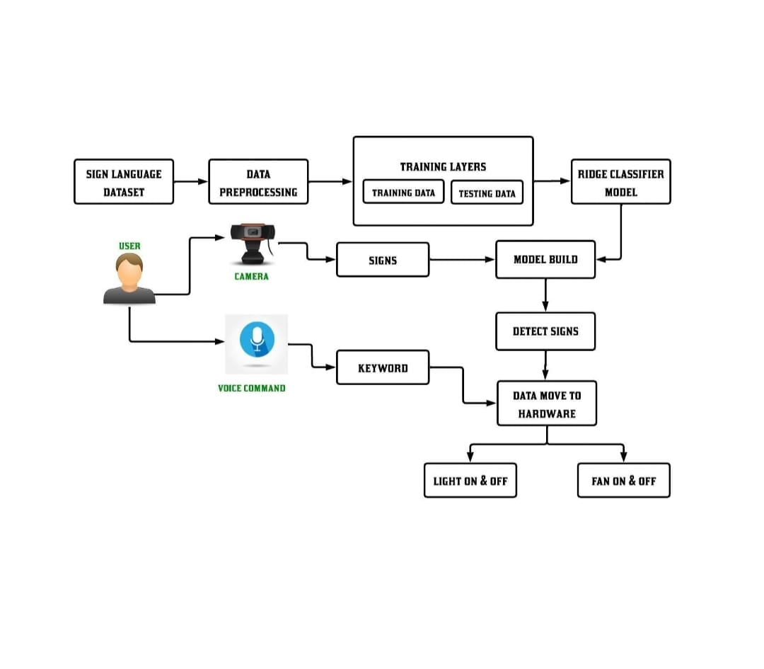
ARCHITECTURAL DIAGRAM

Slide 11
MODULES
Gesture detection module
Voice keyword detection module
Command interpretation and integration module
Hardware control module

Slide 12
IMPROVEMENTS OVER EXISTING SYSTEM
Dual Input Modes: Speech + Sign.
Increased accessibility for disabled users.
Offline control capability (no internet required).
Low-cost implementation with open-source tools.

Slide 13
Result and Conclusion
This Multi model smart home automation System enhances accessibility and user experience with accurate multimodal command recognition.
The project proves the potential for intelligent, responsive, and user-friendly smart home environments.
In conclusion, this project offers an innovative and accessible solution for controlling essential household appliances.

Slide 14
REFERENCES
Lin Sun & Bernt Schiele, "Two-Dimensional Parallel Spatio-Temporal Pyramid Pooling for Hand Gesture Recognition", IEEE TPAMI, 2015.
Ahmed M. & Khan R., "IoT Smart Home with Multi-Model Learning and Blockchain Integration", International Journal of Computer Applications, 2024.
Wang et al.,
“Optimization of inter-subject sEMG-based hand gesture
recognition tasks using unsupervised domain adaptation techniques,”
Biomed. Signal Process. Control, vol. 92, Jun. 2024, Art. no. 106086,
doi: 10.1016/j.bspc.2024.106086.

